Slide 1
Project 1
SAT & ACT Analysis
Chan Song Yuan
General Assembly DSI14
November 4, 2020

Slide 2
ACT & SAT Testing
In this project, we use codes to plot and identify the key questions by comparing ACT & SAT data set.
What to be study and learn from ACT & SAT test data of year 2017 & 2018?
Recommendation on how to improve the SAT participation rate?

Slide 3
Data That We Reviewed...
The data reviewed from SAT and ACT datasets for all US states from 2017 and 2018 :
ACT Participation Rates
ACT English Scores
ACT Maths Scores
ACT Reading
ACT Science
ACT Composite Scores
SAT Participation Rates
SAT Evidence-based Reading & Writing Scores
SAT Maths Scores
ACT Total Scores

Slide 4
The Data is Messy! Clean Up Data
The data were come from different sources so we before we start analysis the data, data study and cleaning is important!
Check the format consistency
Remove the values which is not in use
Remove empty cells / row / colums
Combining datasets
Check for error in values
Filter the errors and do data cleaning
Amend the error and start analysis!

Slide 5
Exploratory Data Analysis (EDA)
Once the data cleaning process done, now let’s start analyze the datas!
ACT vs SAT Scores within states
Participation rates vs scores
Changes in scores and rates
Year 2017 vs 2018 performance for each subject
Participation rates of Year 2017 vs 2018’
Then we can start to plot graphs to visualize our datasets !

Slide 6
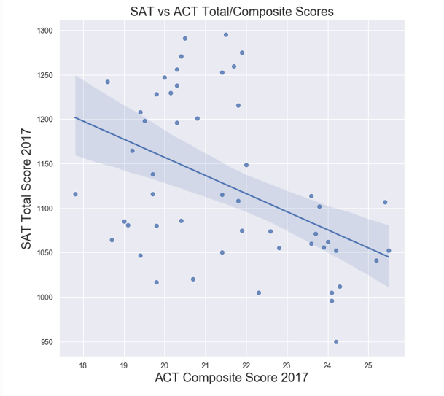
Observations From ACT & SAT Data
Visualization
ACT & SAT Test Scores
By comparing both ACT and SAT test scores we can identify particular states student performance. Each data hold a relationship with each other. As example, the higher score in one test, the average score for the other will tend to be lower.
The relationship can be seen in the regressed linear line on the scatter plot of comparison ACT composite score and SAT total scores in year 2017.

Slide 7
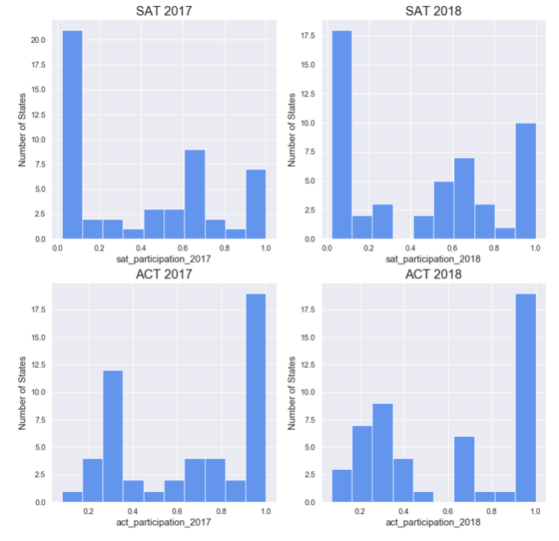
Observations From ACT & SAT Data
Visualization
Participation Rates
There is contrast between the ACT and SAT participation rates among each states.
ACT seems more popular than SAT as we can see obvius skewness to the right in 90% - 100% participation due to the change of policy of college admissions.
Increased to 6 to 10 states in a year of 100% participation rate

Slide 8
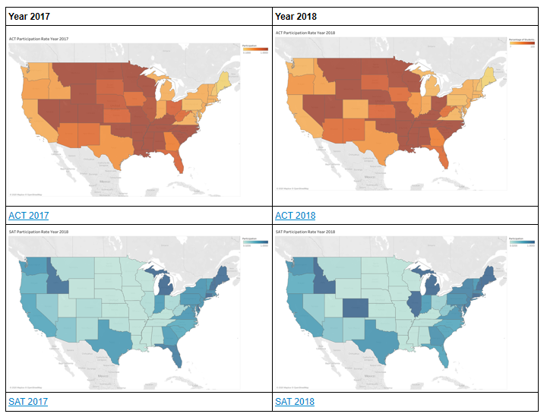
Observations From ACT & SAT Data
Visualization
Participation Rates
By comparing the map which indicate the darkest orange color indicate the 100% participation rate of ACT test while darkest blue indicate the 100% participation rate of SAT test.
The ACT is more concentrated in central of US while SAT is popular in coastal states,

Slide 9
Conclusions & Recommendations
Recommendation
Target the states which yet to review local college admission provider policies
Lower the test entry cost to reduce the low income family burden
Create workshops and seminar to increase student interest on the test
Showcase the improvement of the test
Engaging local department of education to offer discounted price to needed student
Conclusion
Additional data of headcount of the student in respective states
Having university admission criteria of each state which lead to spike or nosediving of the participation of the test

Slide 10
THE END

